Slide 1
Hope in Christ: the hope we profess
Hebrews 10:19-23, 1 Peter 3:13-17

Slide 2
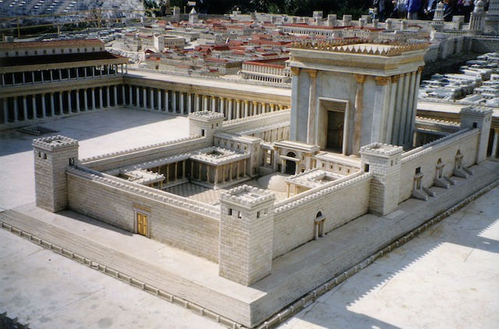

Slide 3
